Slide 1
Understanding the Financial Aid Process
College Cost

Slide 2
What is Financial Aid?
Money to help bridge the gap between the cost of education and what the family can pay.
Sources of Financial Aid include:
U.S. Federal Government
State where you live
Colleges and Universities
Private Organizations

Slide 3
Types of Aid
Merit-based
Need-based
Awarded to students who demonstrate a high level of achievement in: - academics - athletics - arts - leadership
Family financial information is not taken into consideration.
Awarded to students based on their demonstrated financial need.
Financial need is determined based on student and parent financial information from one or possibly two forms.
FAFSA
CSS Profile

Slide 4
How to apply for Merit-based Aid
Merit-based application process varies by college or university:
Automatic consideration just by applying for admission
Separate application (watch for different timelines and deadlines)
Both

Slide 5
How to apply for Need-based Aid
File the FAFSA form
Available in December 2024 for the 2025-26 academic year
Required of all schools where you want student to be considered for need-based aid
Must be completed for every year a student will be attending college or university
The number of the family in college is not included in the calculation
Some schools may also require the CSS Profile
Utilized to award institutional aid at more selective private institutions
Some schools may have an institutional form

Slide 6
Financial Aid Applications
FAFSA
CSS Profile
Submitted by the parent(s) who provide the most financial support
Free
Both Student and Parent(s) must set up a Federal Student Aid User Name and Password (FSAID)
Calculates the student’s SAI
Used to determine eligibility for federal, state, and institutional aid
Submitted annually
Submitted by the custodial and some schools require non-custodial parent
$25 application fee for the first school and $16 for each additional school
Fee Waivers are available
Calculates an Estimated Contribution
Used to determine eligibility for institutional aid only
Varies by school; annually or first year only

Slide 7
Completing the FAFSA – FSA ID
Apply for a FSA ID (Username and password)
Every contributor will need a FSA ID
Email addresses associated with FSA ID accounts must be unique
Contributors include everyone required to provide information on the FAFSA: Student, Student’s spouse, Biological or Adoptive Parent, Parent’s spouse or partner
If parents filed taxes separately, both parents are contributors
Parent(s) must have their own FSA ID
Parents who do not have SSN can get FSA ID
FSA ID serves as electronic signatures for the FAFSA and Promissory notes
https://studentaid.gov/fsa-id/create-account/launch

Slide 8
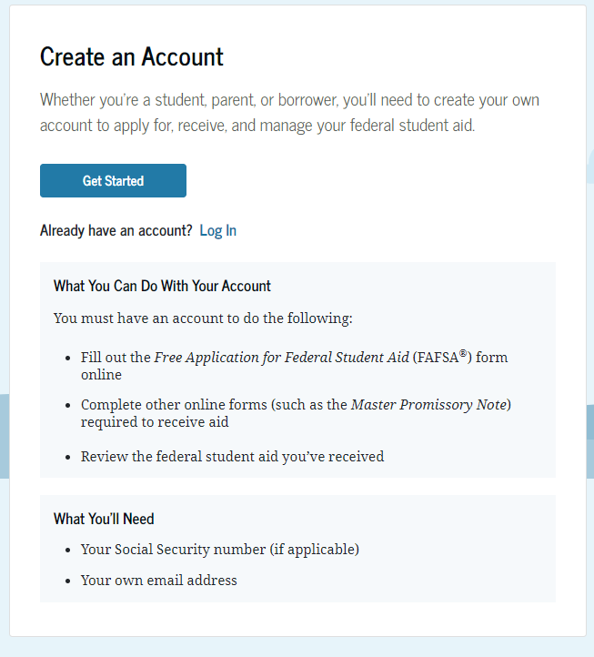

Slide 9
Completing the FAFSA
FAFSA is based on prior, prior year taxes
2025-26 FAFSA is based on 2023 taxes
FAFSA will be available December 1st
Beta version is now available.
The FAFSA is student-specific
Students must re-apply for aid every year
Dependency Status, studentaid.gov/apply-for-aid/fafsa/filling-out/dependency
Student may list up to 20 schools
Notes:
Wanted to include that it may be intermittently available in case they see it out there.

Slide 10
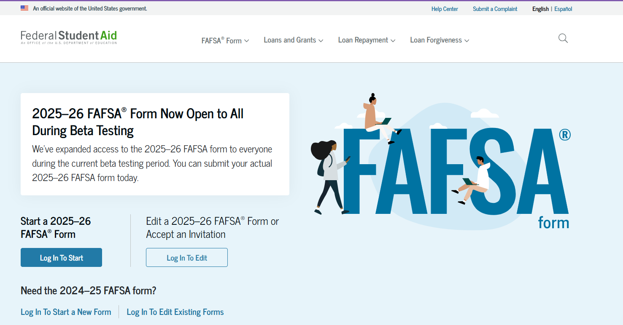
FAFSA Landing Page studentaid.gov/h/apply-for-aid/fafsa

Slide 11
Whose Financial Information is required?
For dependent students both the student and their parent(s) are contributors
Their parent(s) who provides the most financial support
Married parents filing joint return – 1 parent contributor
Married filing separately – both parents are contributors
Not married but both biological parents are living together – both parents are contributors
Everyone must provide consent for the FAFSA to be valid
Non-filers must also provide consent
If consent is not provided the FAFSA can be completed but the student will not be eligible for Federal Student Aid.
*Must complete the process within 45 days or start over (incomplete applications are deleted after 45 days)
Notes:
Leaving the 45 day requirement on the slide since we don’t know if that will be enforced or not, I would rather put it out there than have a family surprised if it is enforced.

Slide 12
What Financial Information is required?
For the 2025-26 Academic Year the Future Act Direct Data Exchange (FA-DDX) will pull information from your 2023 federal tax return
You will manually provide the following information, if applicable:
Child Support Received for all children - most recently completed calendar year
Cash, Savings, Checking - day FAFSA filed
Net Worth of Business and/or Farm – day FAFSA filed
Investment Net Worth – day FAFSA filed

Slide 13
What happens after the FAFSA is filed?
The Student Aid Index (SAI) is calculated
Results are sent electronically to the selected college(s)
Expect delays with schools receiving information
The applicant will receive a FAFSA Submission Summary
If you have extraordinary circumstances notify the Financial Aid Office(s)
You may be required to verify the information submitted on the FAFSA

Slide 14
Determining Eligibility for Need-based Aid
Costs Attendance is comprised of these six categories
Tuition
Course materials, Supplies & Equipment
Fees
Personal Expenses
Food & Housing
Travel

Slide 15
Determining Eligibility for Need-based Aid
Need is a simple equation
Total Cost of Attendance
Student Aid Index
(SAI)
Financial Need

Slide 16
Examples of the “Math”
Public College
Private College
Cost $55,800
SAI -$10,000
Need $45,800
Cost $ 27,330
SAI -$10,000
Need $ 17,330

Slide 17
Your student’s Financial Aid Award
Will be comprised of assistance from one or more these categories depending upon their eligibility:
Scholarships and Grant
(Free Money)
Student Employment
(Earned Money)
Student Loans
(Borrowed Money)

Slide 18
Grants
Need-based
Federal Grants
Pell
SEOG
TEACH
State Grants
Institutional Grants

Slide 19
Student Employment
Two Types:
Federal Work Study
Regular Campus Employment
Can be used for personal expenses
Working should not adversely affect grades

Slide 20
Federal Direct Student Loans
Subsidized = Need-based
Unsubsidized = Anyone can borrow
Annual amounts
Freshmen: $5500
Up to $3500 subsidized
Sophomores: $6500
Up to $4500 subsidized
Juniors/Seniors: $7500
Up to $5500 subsidized
6-month Grace Period
10-year Standard Repayment

Slide 21
Other Options
Parent PLUS Loan
https://studentaid.gov/plus-app/parent/landing
Student Alternative Loans – Private Lenders
Private Scholarships
Must be reported to the school
Payment Plan
Tax Credits
529 Plans

Slide 22
Resources
Net Price Calculators
Early Financial Aid Estimation Tool
On every College Website
Cost – Grants & Scholarships = Net Price
Websites
studentaid.gov
consumerfinance.gov/paying-for-college/
bigfuture.collegeboard.org/pay-for-college

Slide 23
College Goal Wisconsin
collegegoalwi.org
Get help filing the 2025-26 FAFSA
In-person and virtual events: collegegoalwi.org/calendar-of-upcoming-events/
Register online
View required documents

Slide 24
Additional Information
Marquette Central
Office of Student Financial Aid
Marquette University
phone: 414.288.4000
email: marquettecentral@marquette.edu
Website: marquette.edu/central/financial-aid
Jinny Apuli: jinny.apuli@marquette.edu

